Slide 1

New Cube Design
7.8.24 version 1.0

Slide 2
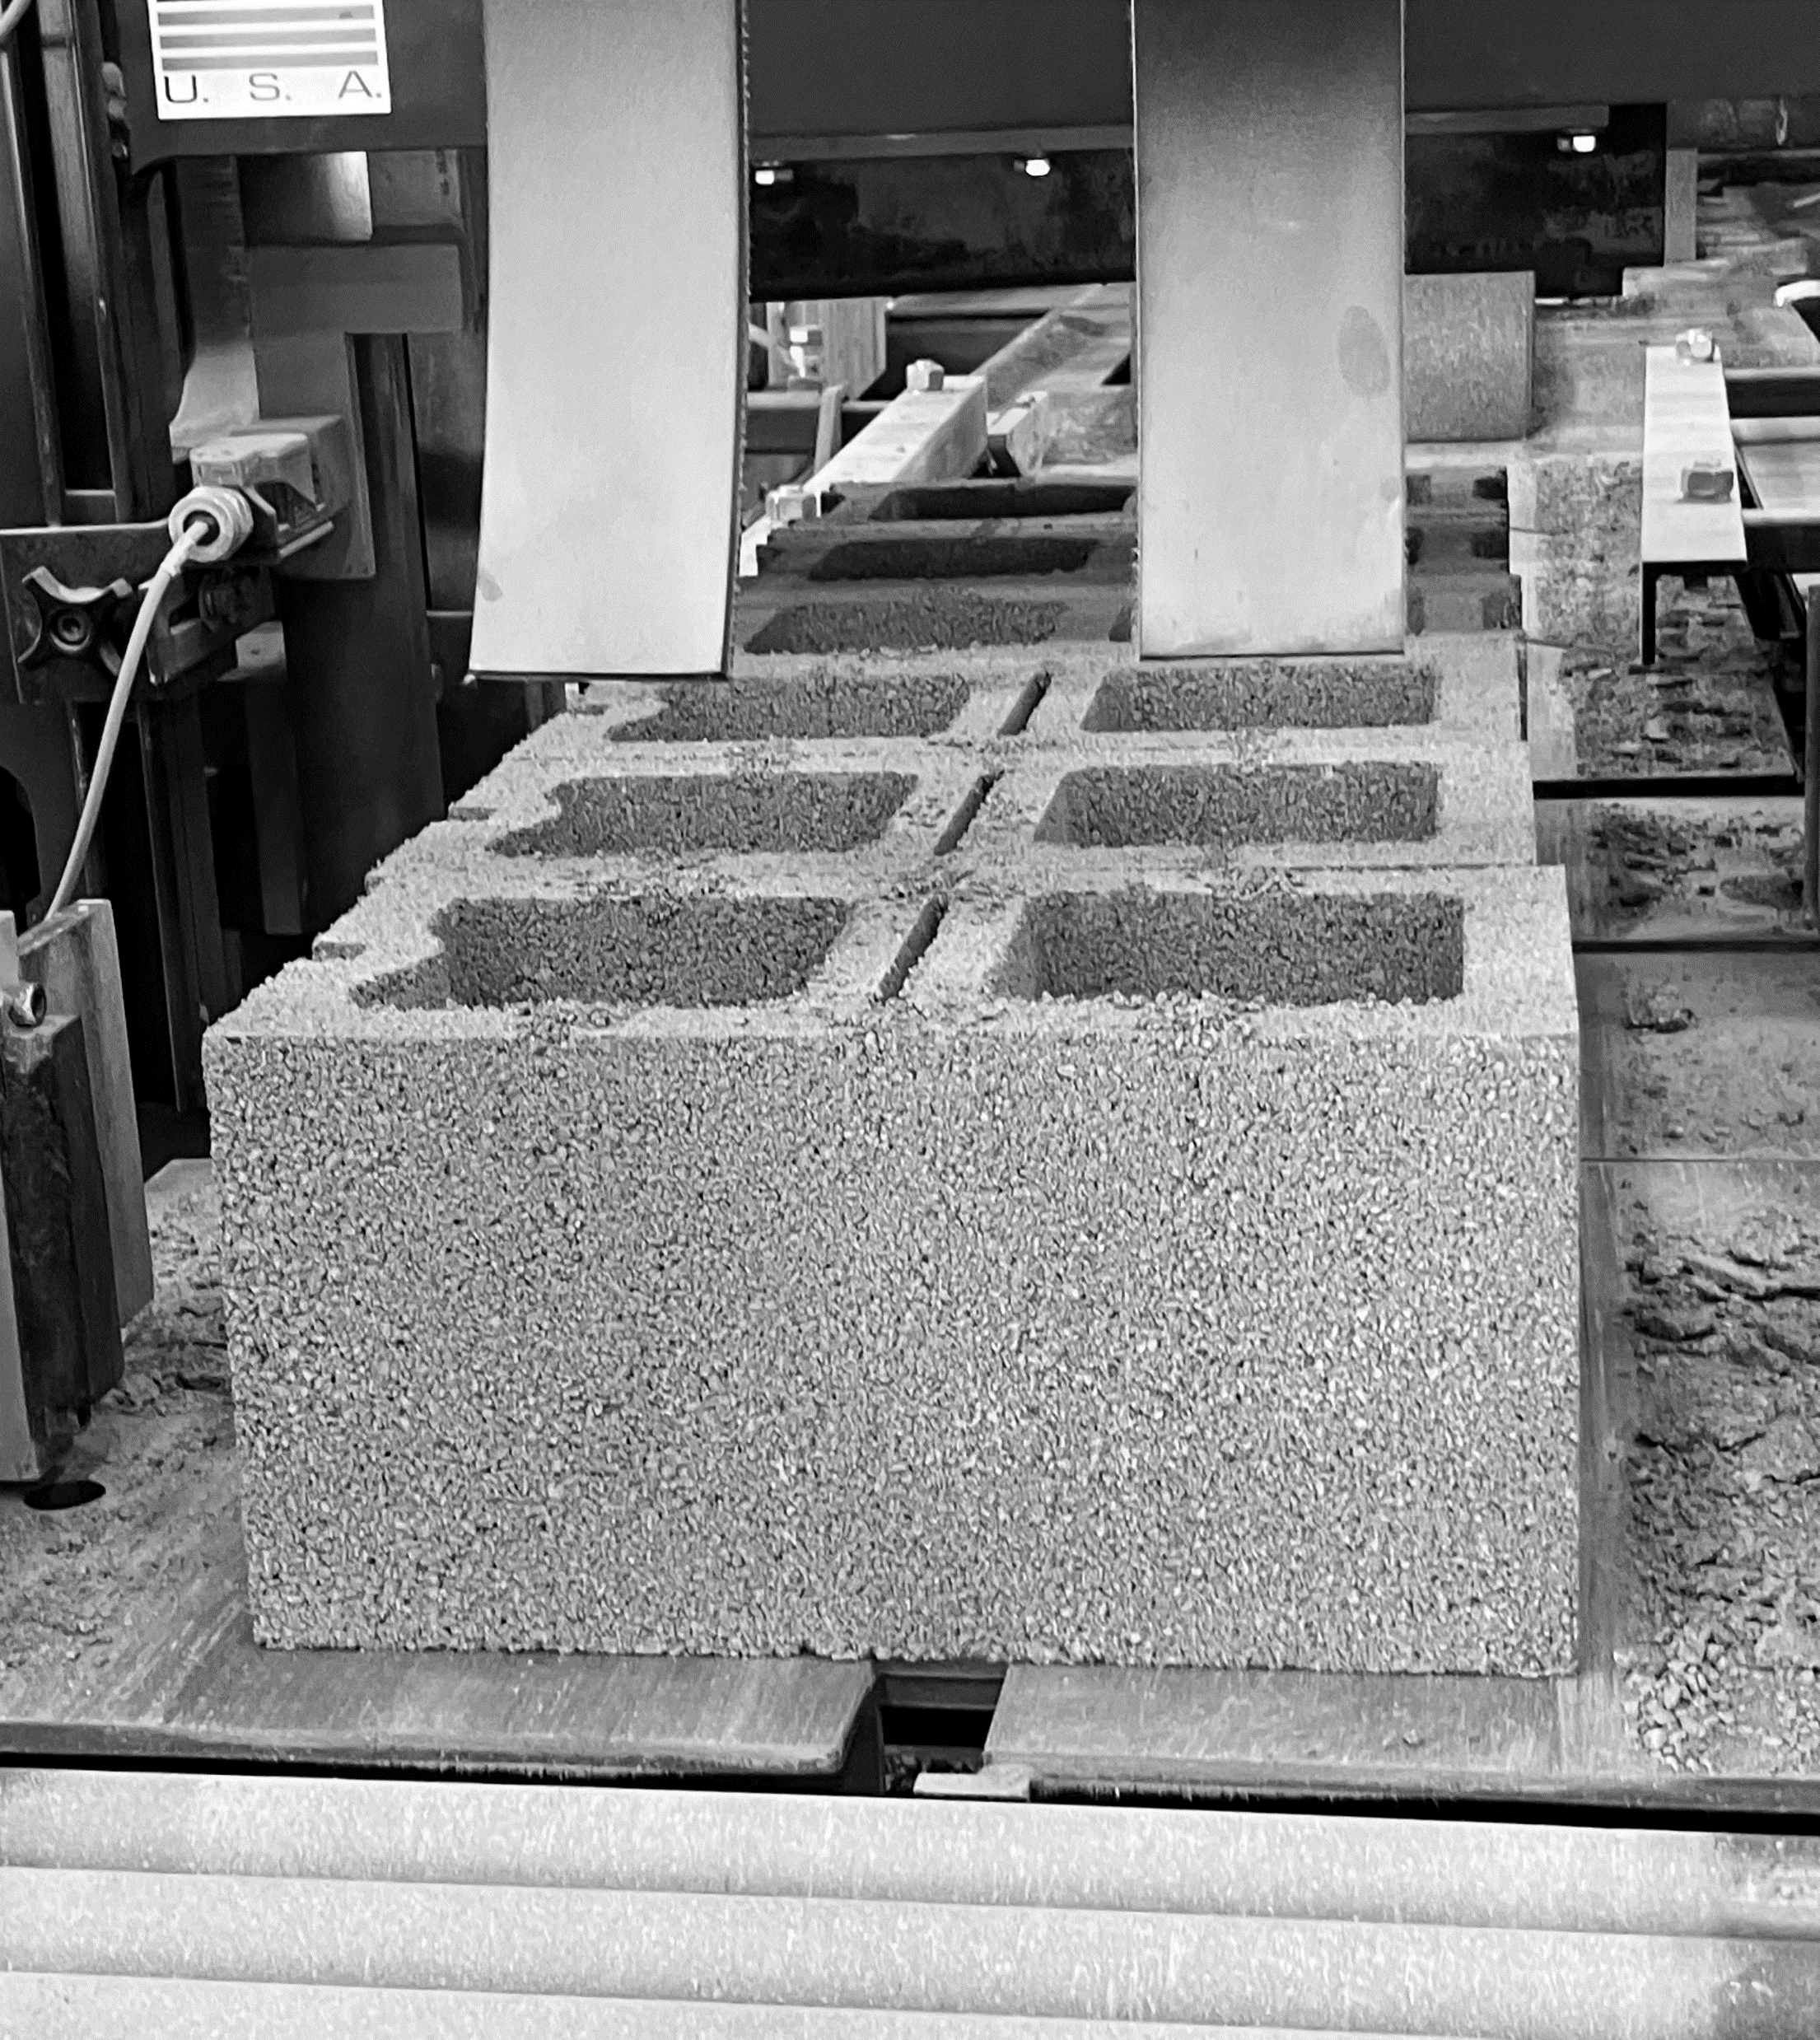
Assumptions and Prerequisite Skills
Machine is running
Supplies Needed
Standard PPE

Slide 3
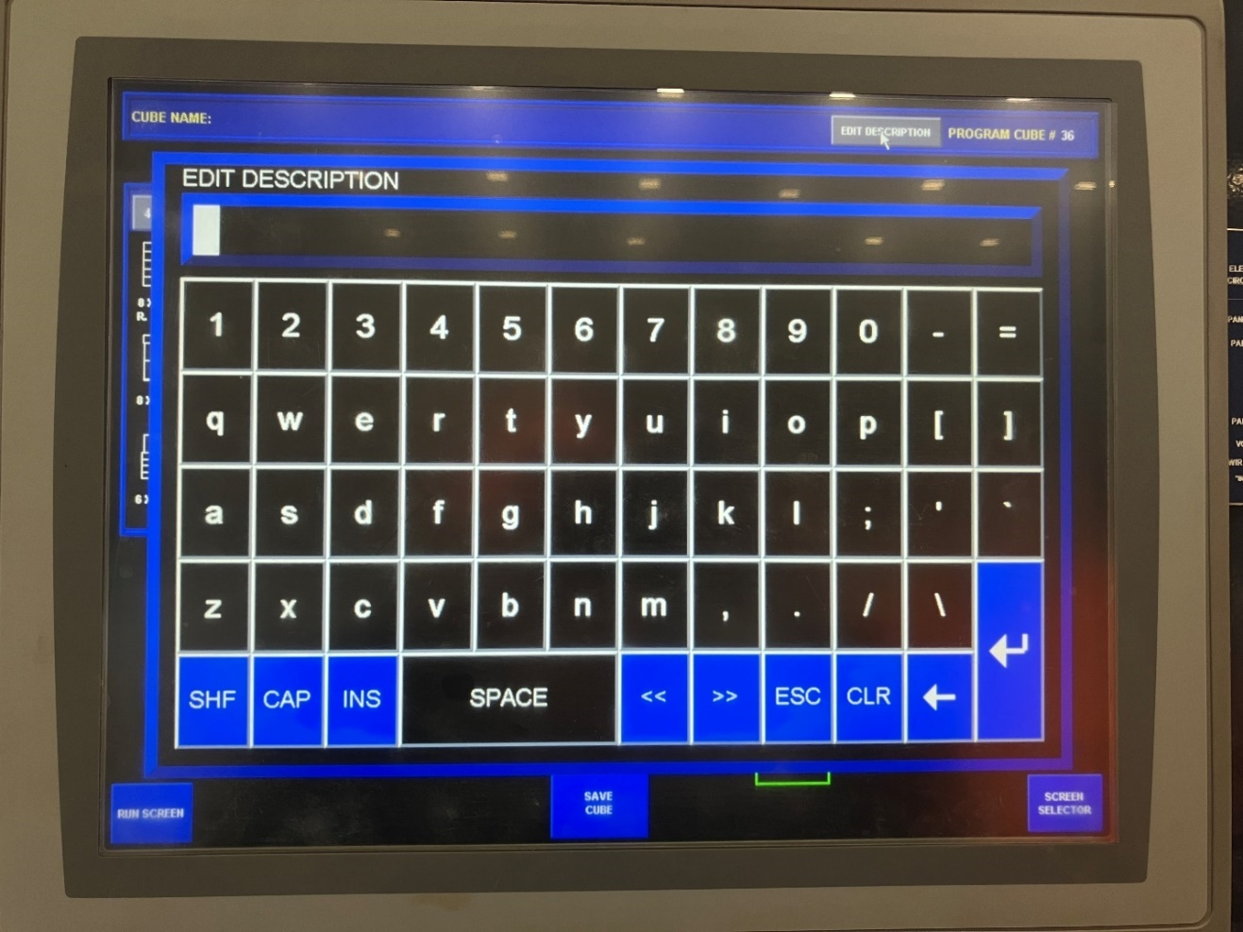
To design a pattern, choose an empty number. Press the blue “Enter Product to Program Directly” button on the right side of the screen. From there, enter the desired number and press the number and press the enter key (red circle).
At the top of the screen, select “Edit Description” to add a name to the pattern. Select enter (Figure 1).
Figure 1

Slide 4
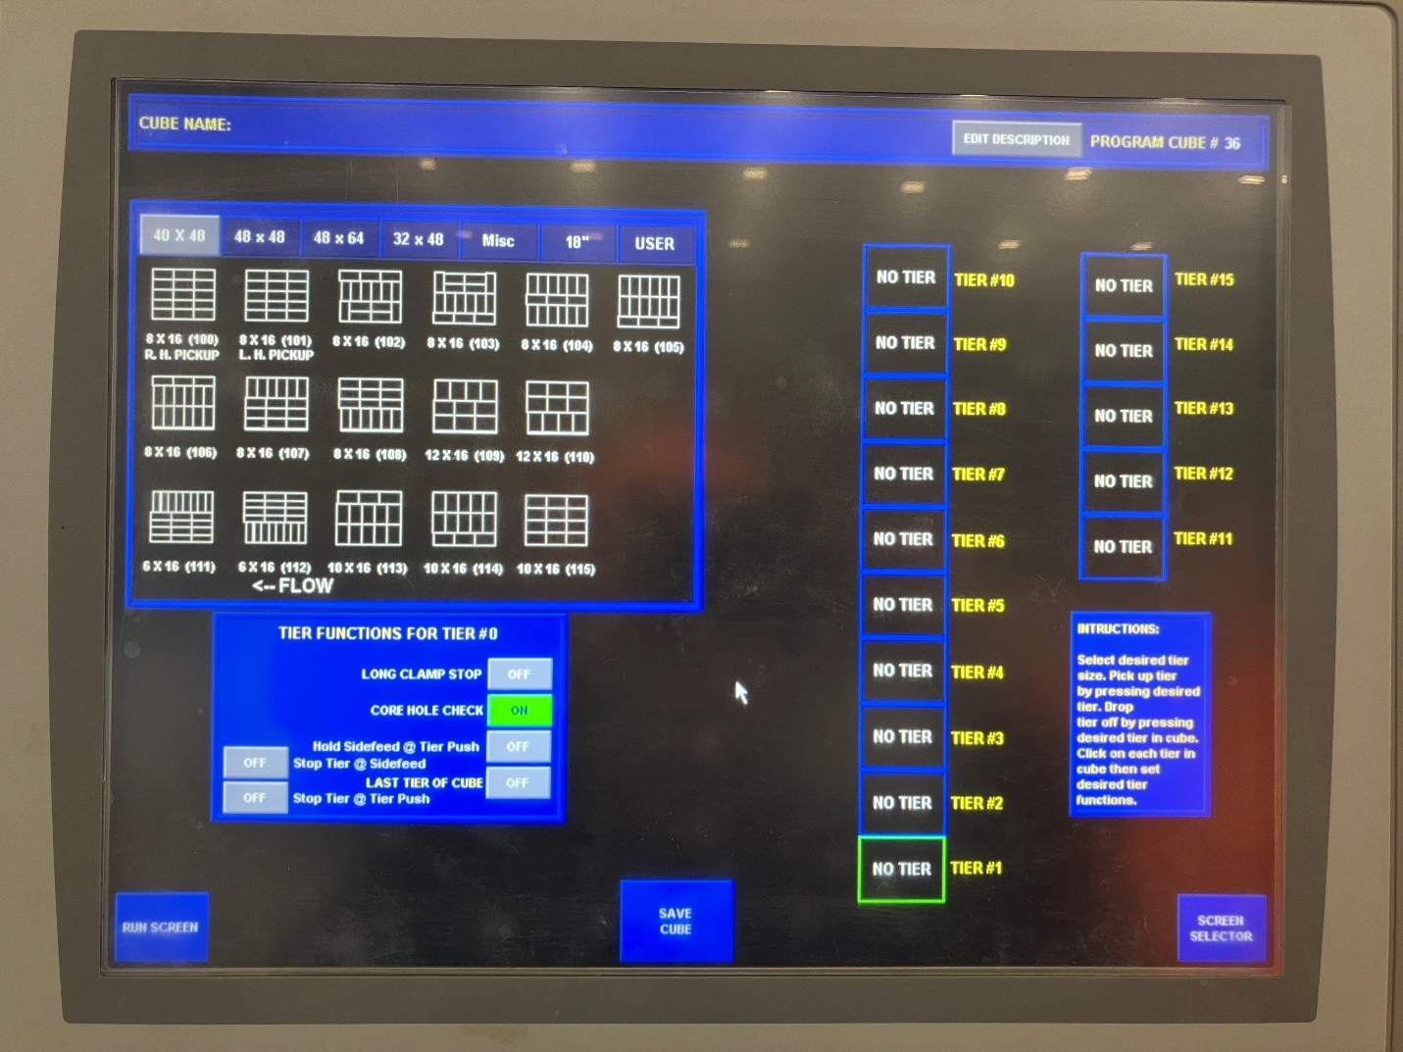
3. Choose a pattern from the options in the top left corner by clicking on the desired pattern and then clicking on the desired tier (Figure 2). For the bottom tier, select “Core Hole Check” to ensure blocks are facing the correct direction. The holes must be facing the same direction on the bottom tier so that a forklift’s forks can go through and pick the cube up.
Figure 2
Note: If you are putting a cube on a pallet, do not turn “Core Hole Check” to on. Keep it to Off.

Slide 5
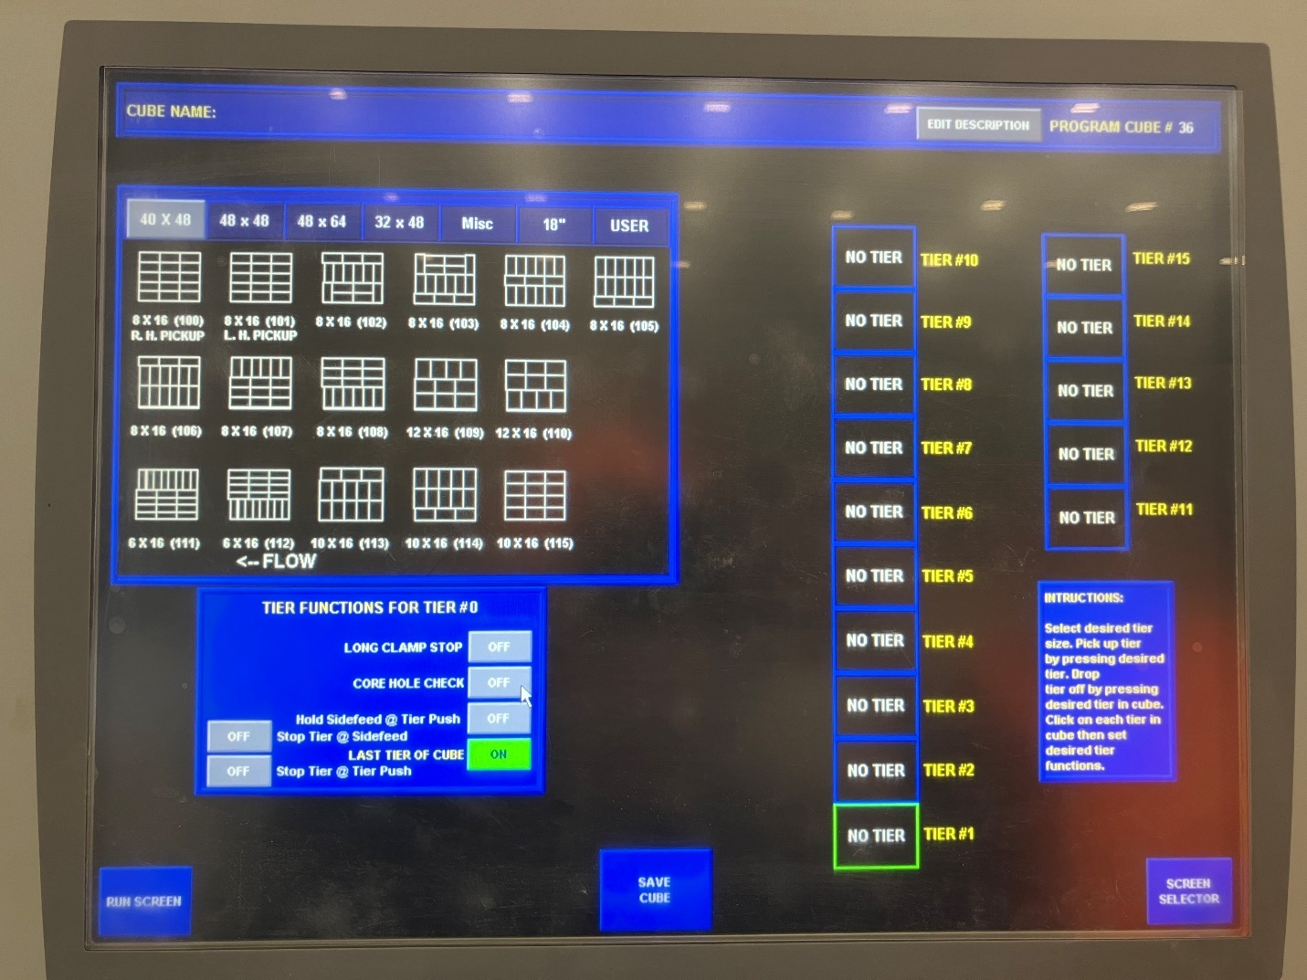
4. For each inner tier, select the pattern you’d like for each specific tier. For the top tier, select “Last Tier of Cube” so the machine knows this will be the last layer of the cube (Figure 3).
Figure 3

Slide 6
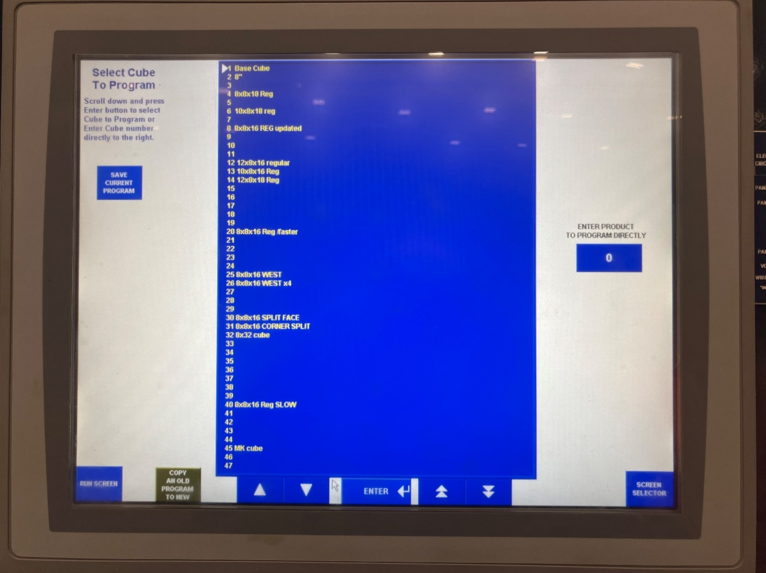
5. To copy a cube pattern onto another program, select the “Cube an Old Program to New” button in the bottom left corner of the screen (Figure 4).
Figure 4

Slide 7
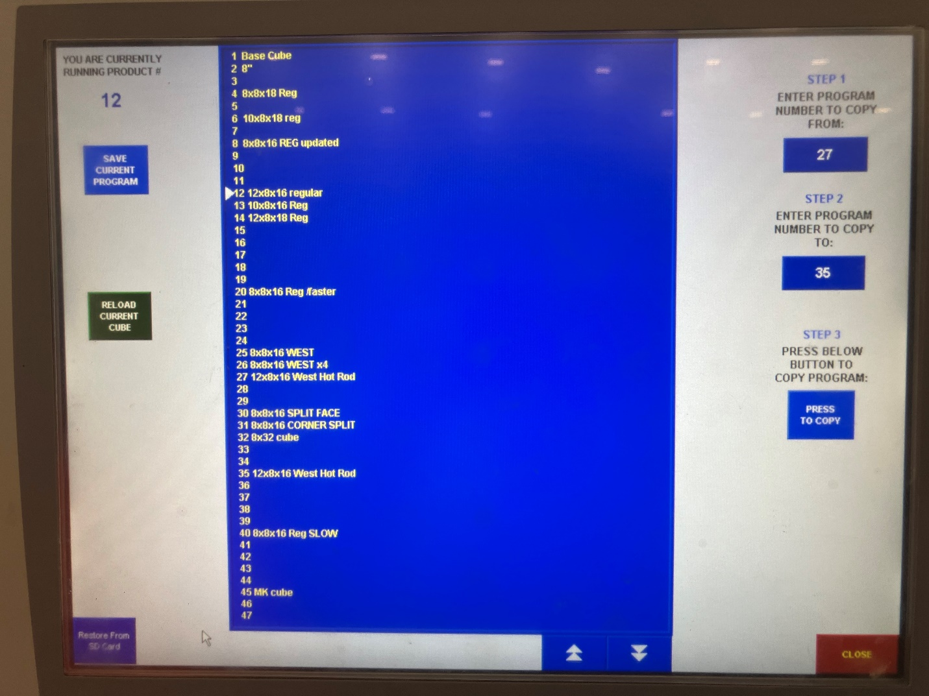
6. Type the number of the program you would like to copy in the “Step 1: Enter Program number to copy from:” box on the left of the screen (yellow arrow). In the “Step 2 Enter program number to copy to:” button, enter the program number you would like to copy to (red arrow). Next press the Step 3 “press to copy” button to run the program. From there you can make your desired changes to the new program (Figure 5).
This completes the process.
Figure 5

